Slide 1


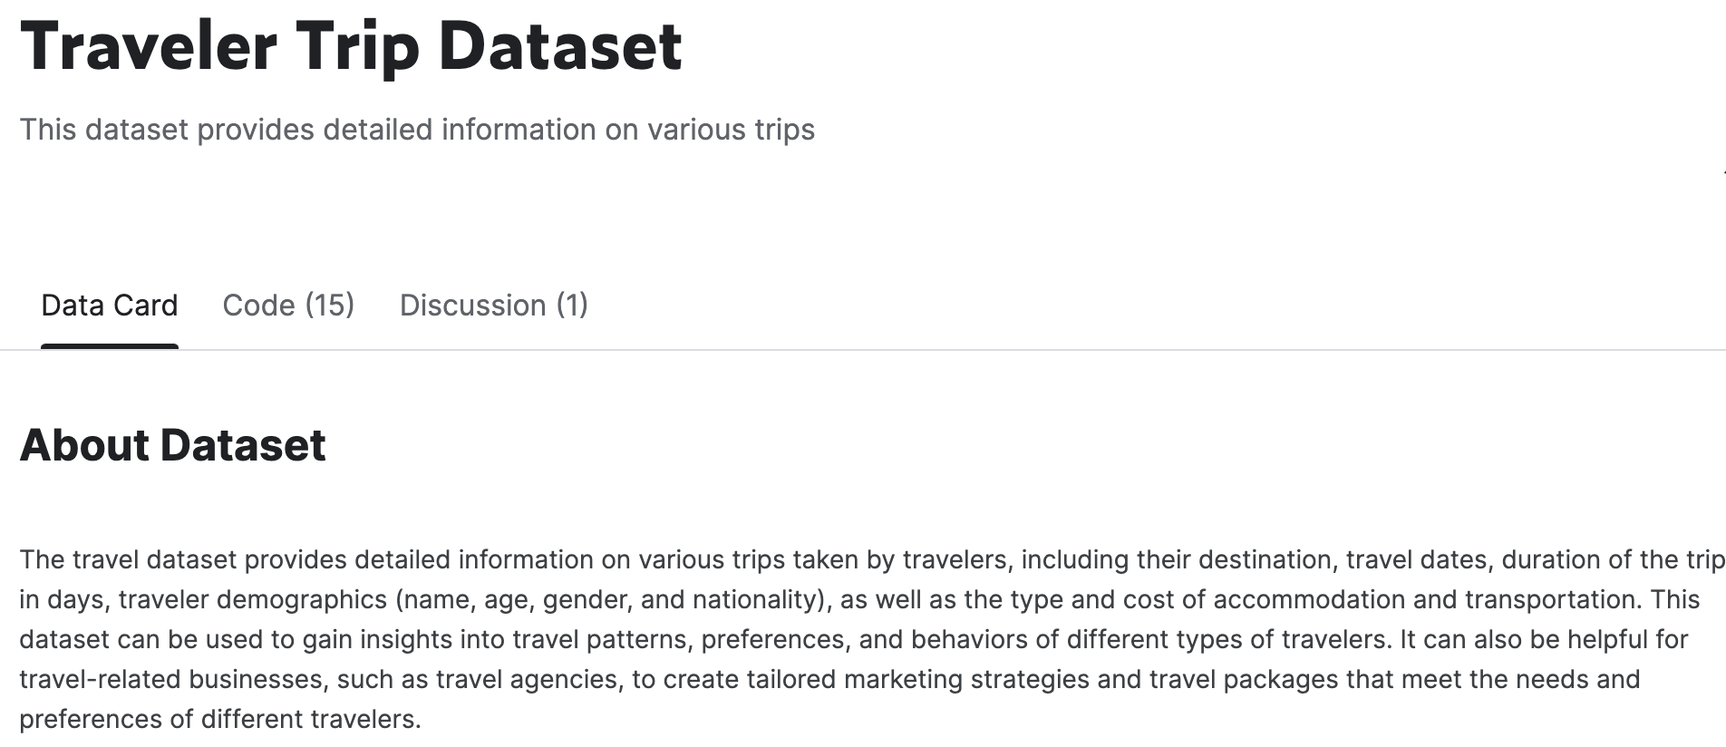

Renata O-Stewart Tharshika Tharsan Verena Sarrazin
Group 12
Python & Apps

Slide 2
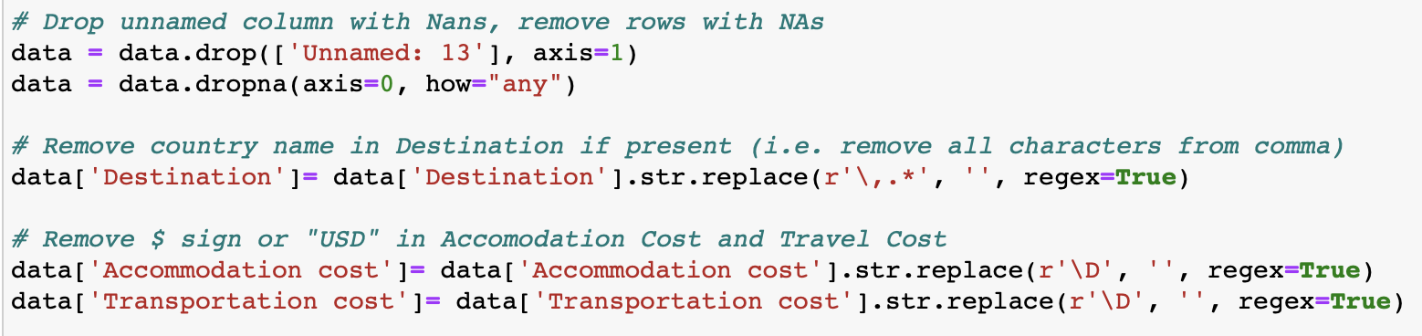
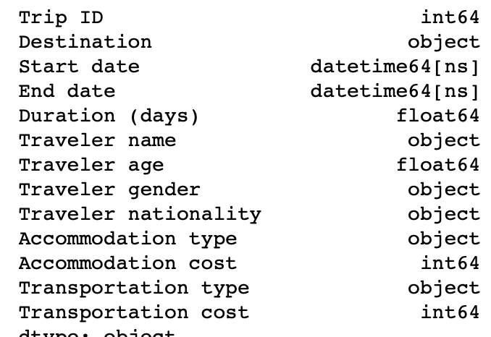
Traveler Trip dataset (Kaggle.com)
Deal with missing data, make naming consistent, etc.
Structure
Formatting
Exploration
Analysis
Visualisation

Slide 3
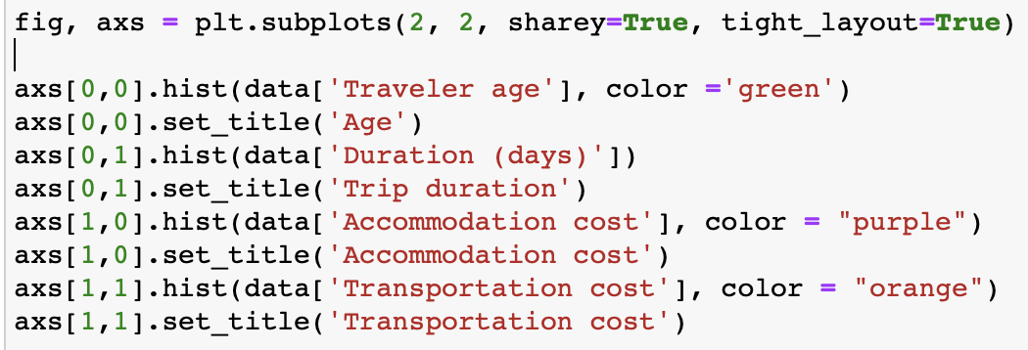
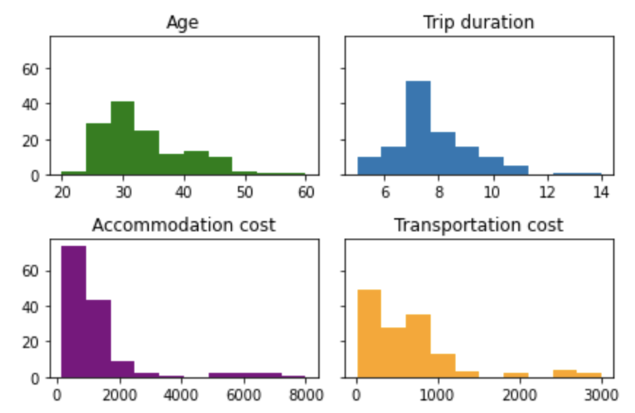
Traveler Trip dataset (Kaggle.com)
Structure
Formatting
Exploration
Analysis
Visualisation

Slide 4
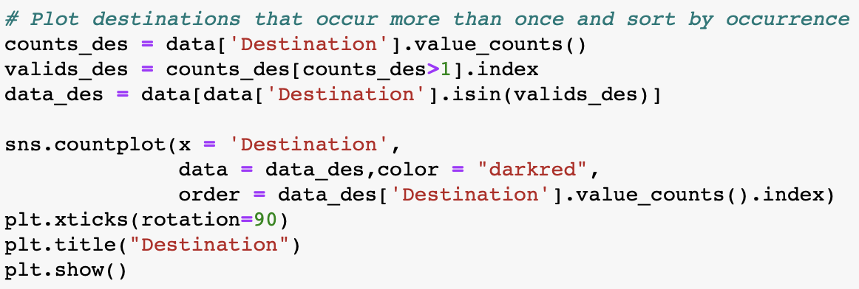
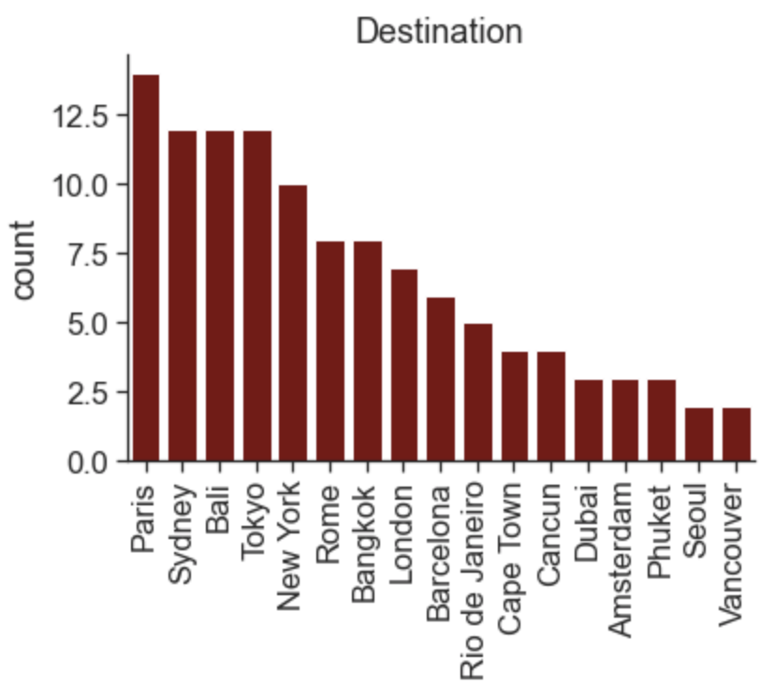
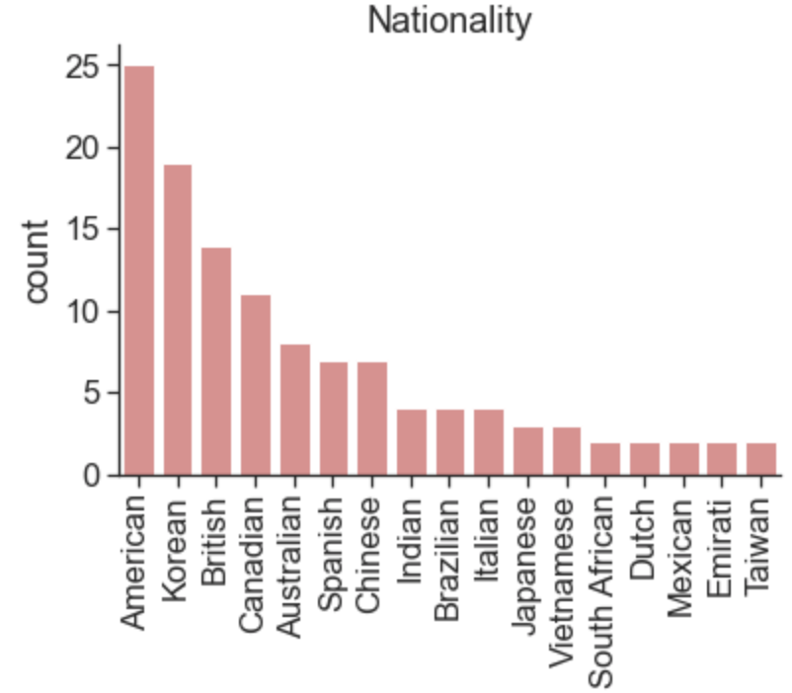
Traveler Trip dataset (Kaggle.com)
Structure
Formatting
Exploration
Analysis
Visualisation

Slide 5
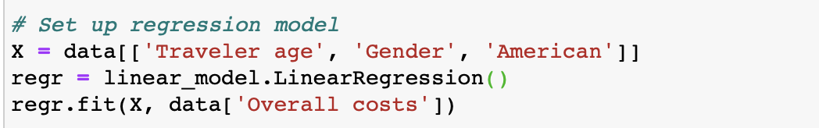
Traveler Trip dataset (Kaggle.com)
Can age, gender and nationality predict how much money people are willing to spend on a trip?
Structure
Formatting
Exploration
Analysis
Visualisation
→ Regression analysis

Slide 6
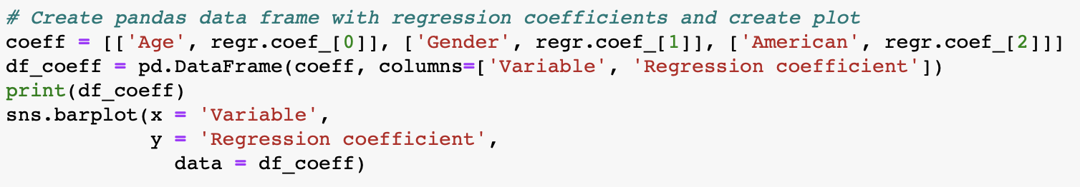
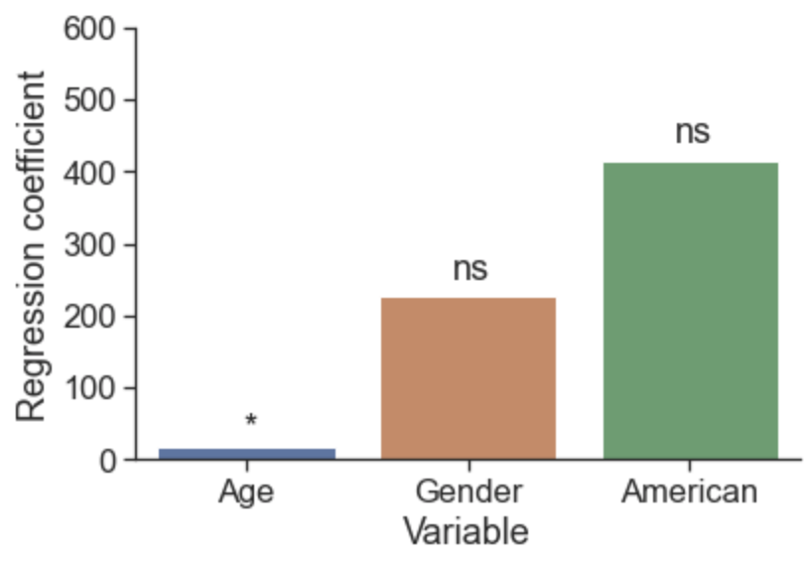
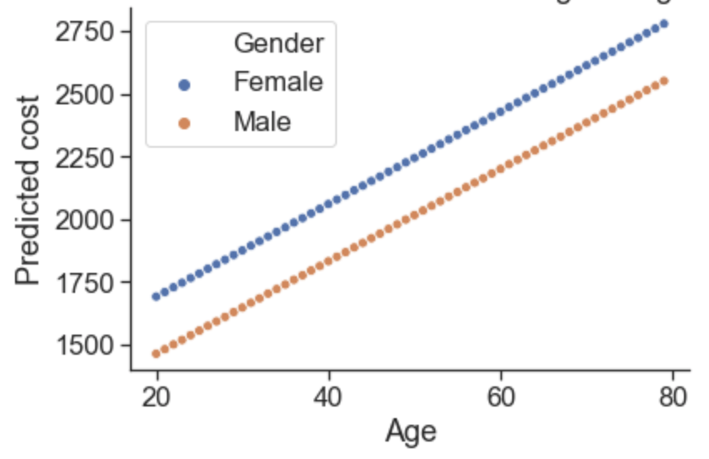
Traveler Trip dataset (Kaggle.com)
Can age, gender and nationality predict how much money people are willing to spend on a trip?
Structure
Formatting
Exploration
Analysis
Visualisation
Parameter estimation
Model prediction

Slide 7
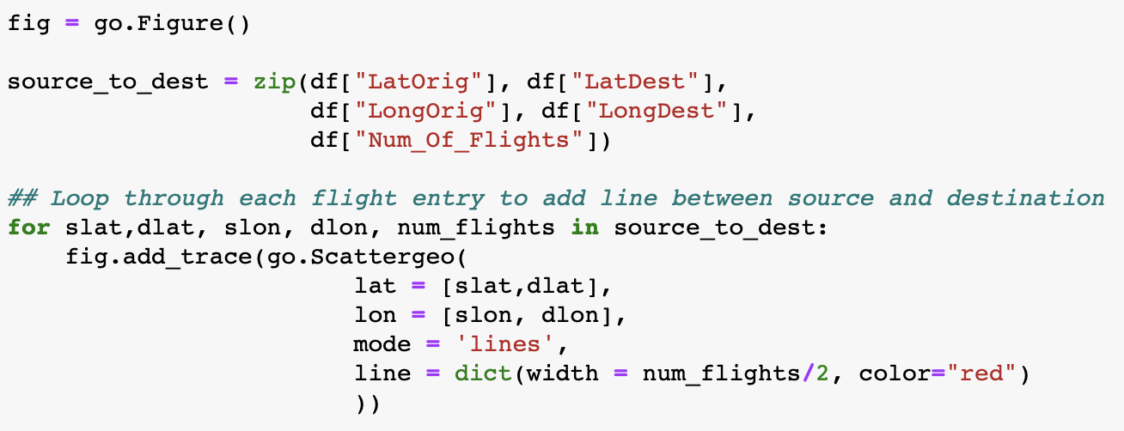
Traveler Trip dataset (Kaggle.com)
Interactive world map
Structure
Formatting
Exploration
Analysis
Visualisation
Tutorial: https://coderzcolumn.com/tutorials/data-science/how-to-create-connection-map-chart-in-python-jupyter-notebook-plotly-and-geopandas#1

Slide 8
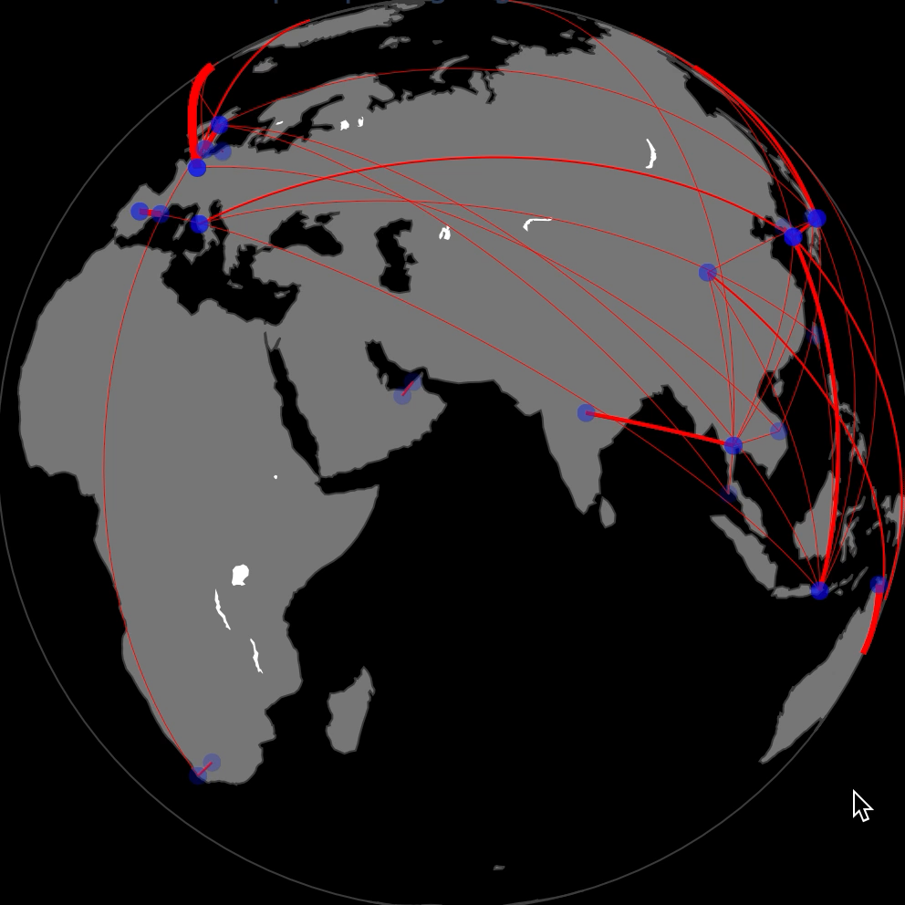
Traveler Trip dataset (Kaggle.com)
Structure
Formatting
Exploration
Analysis
Visualisation

Slide 9
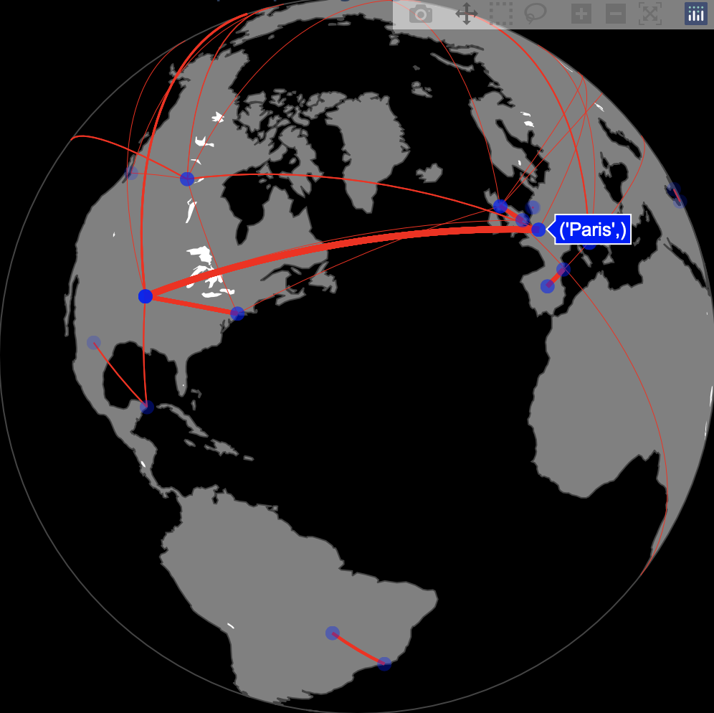
Traveler Trip dataset (Kaggle.com)
Interactive world map
Structure
Formatting
Exploration
Analysis
Visualisation

